Slide 1
Lending Club Loan Default Analysis
Rashmi Kalra
STA 536

Slide 2

Overview
About Lending club & Business Problem
Explanatory Data Analysis
Data Preparation & Processing
Unsupervised Learning
Supervised Learning Models
Summary of results
Future work
Notes:
This is the general overview of what we are planning to present today.
First we will give an overview of Lending club and what is the business problem we are trying to solve.
Then we will discuss about the data explanatory analysis that we performed on the data set.
Following this we will briefly discuss the about the data set, how we prepare and set up the data for our machine learning model.
After that we will take a closer look at the machine learning process and how we use the spark MLlib to implement the machine learning algorithms.
And then summary and conclusion

Slide 3
Overview of Lending club and the Business Problem
Lending Club is a Peer-to-Peer lending company that utilizes group of private investors
to fund loan requests.
Lending Club assigns each borrower a grade and subgrades based on their credit history
Investors are presented with a list of loan requests along with their grades and borrower details which they analyze and then select loan request they will fund/partially fund
Lending Club makes money by charging borrowers an origination fee and a service fee to investors
Our business problem is to build a model which will give a more comprehensive assessment of borrowers credit risk than what is presented by Lending Club in order to reduce investment risk.
Lending Club
Borrower
Investors
Notes:
Lending Club is an online peer to peer credit marketplace which matches borrowers and investors.
Lending club assigns each borrower a grade and a sub-grade based on their credit history.
These grades are assigned within alphabetical range from A to G. Each of these letter grades has five finer-grain sub-grades, numbered 1 to 5, with 1 being the highest category with-in the grade
They evaluate their credit-worthiness based on these grades
This rating information is made available to all the investors who fund the load requests.
The grading help the investors to make a decision of which loan request they will fund. Or how much of that loan request they want to fund.
In addition to these grading lending club provides historical performance data to the investors so that they can perform more comprehensive analysis.
Our goal is to perform explanatory data analysis using apache spark framework to develop business insights from the historical loan data.
As per the recent studies 3-4% loans default every year. This is a huge risk for investors. So our goal is to develop a model which identifies which borrowers are more likely to default on their loans. This model can be used by investors to limit their investment risk.
Lending Club makes money by charging borrowers an origination fee and investors a service fee.

Slide 4
Data Description
Lending Club has provided historical loans data that includes :
Loan origination data from 2015 - 2018
Borrower’s past credit history
Employment and income details
Lending Club loan information
Loan information for different terms 36 months and 60 months
Loan status ( Charge-off or Fully paid and some others)
The total dataset consisted of 151 features and over 2 million records.
Since the data is very vast so for the model building purpose, we used the data from 2017 and used the loan term 60 months
We only need variables which have direct response to borrower’s potential to default. We used feature selection techniques and business knowledge for choosing relevant variables.
Target variable – loan status (Charge-off = bad, fully paid = good)
This data is structured data with lot of missing/null values. Includes continuous, ordinal and nominal feature types.
Notes:
Lending club provides us a good quality of historical data.
We accessed over 800,000 records compiled over the period of year 2007-2015.
The variables which are include in this data set provides ample amount of information from which we could identify that if the borrowers are likely to default on their loans.
We require only selected variables which have direct response to borrower’s potential to default. So we prepared our own data set by choosing these variables.
For explanatory analysis which we performed using apache spark we used the whole data set.

Slide 5
Data Explanatory Analysis
Analyzing Loan amount and Installment
Distribution Plot of loan amount
Loan amount ranges from $10k to $40 with higher proportion of population between $10k to $20k
Distribution Plot of Installment
Installment amount varies from $100 - $1300 with major proportion of population between $150-$700
Notes:
Show on the slide here are the distribution plots of loan amount and interest rate.
We have developed plots for every features to find out the their distributions
We need this distribution to develop the probability distribution function to find out the maximum likelihood of each feature.
Some of the variables have exponential distribution so we developed the pdf for those as well.

Slide 6
Data Explanatory Analysis
Analyzing credit risk based on good/bands across homeownership and employment length
Number of loans based on Homeownership status
Borrowers who have a mortgage or are renting have higher bad rate and are in higher proportion in the data
Number of loans based on Employment length
There are a very high proportion of borrowers with employment length more than 10 years
Notes:
Here we can see that the popularity of LC has increased over the period of time.
The median interest rate was increased during 2012-2013. May be because of some financial crisis during that period!!!
Created bins
Used buketizer – computational expensiv
Wrote cutom logic

Slide 7
Data Explanatory Analysis
Analyzing Annual Income over loan status
Analyzing Loans based on purpose
Default distribution over Annual Income
Borrowers with lower income have more tendency to go bad
Default distribution the loan purpose
Most people take loans for debt consolidation followed by home improvement
Figure: Violin plot for loan status
Notes:
A Violin Plots are used to visualize the distribution of the data and its probability density.
From this violin plot we can see that the loan amount for all the loan status is almost normally distributed.

Slide 8
Data Preparation & Processing
Steps performed during data processing are mentioned below:
Removed all irrelevant fields which do not contribute to data analysis or model building
Target Variable: Loan Status(target variable) has multiple values like Fully Paid, Charged off, Late etc. and we only kept Fully paid and Charged off.
For our classification model we needed to add a class label variable so new target variable ‘default’ is created with 1 if the person default(loan status=Charged off) and 0 (loan status=Fully Paid) if not.
Outlier Treatment: Outliers were present in the variable DTI and Annual Income, so we removed them
Missing Value Treatment: There were multiple missing values present in the variables- Employment length, revol_util. All the missing values are imputed with the median.
Notes:
Though the data was good quality, we found out that we have to perform some cleanup activity.
First we removed the records which have more than 50% of missing values.
Then for better interpretation of results we convert some continuous variables into ranges.
We use StringIndexerAPI to convert the ordinal features such as borrowers experience level and VectorAssemblerAPI to convert the rest nominal features. Following which, we binary encoded the variables with binary values.
For our classification model we

Slide 9
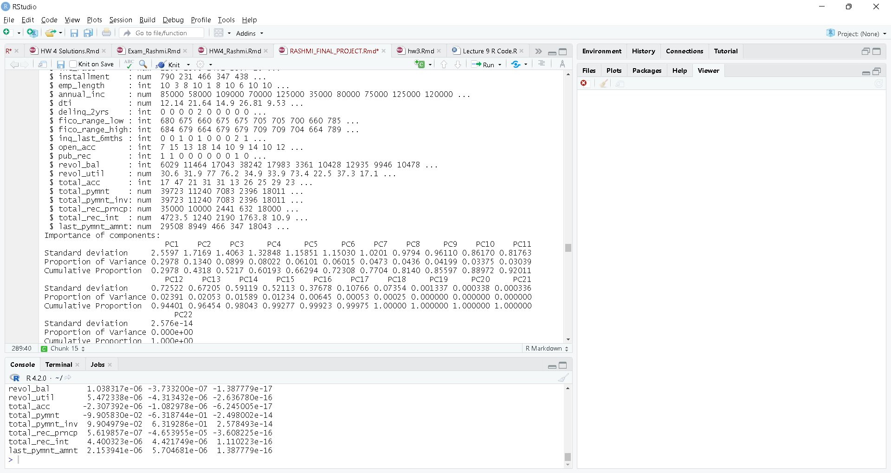
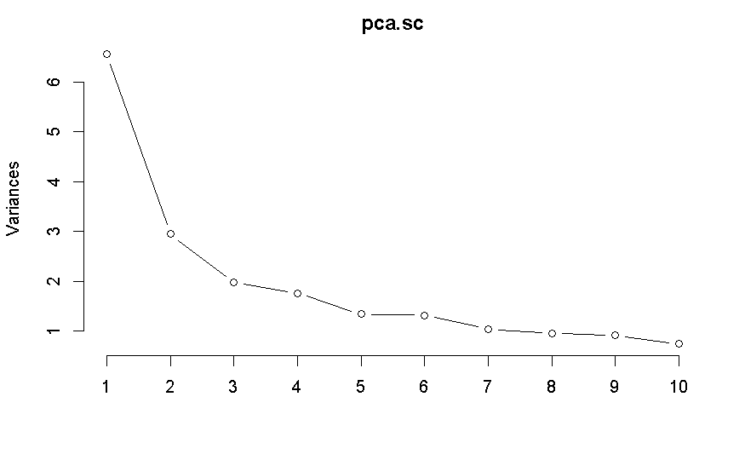
Unsupervised Learning – Principal Component Analysis
Principal Component Analysis is a method of Dimensionality Reduction. Here we reduce a higher dimension to a lower one, retaining the variance of the original one
Our first attempt at running PCA shows that the first PC accounts for about 29.78% of the variation in the data set. The first two PCs account for over 43.18% of the variation and 5 PCs explain about the 66.29% of the variation.
We typically choose the number of PCs based on the elbow of the plot. At that point we are not explaining enough additional variation to warrant including another dimension. Hence, for now we can ignore principal components greater than 3.
Notes:
Though the data was good quality, we found out that we have to perform some cleanup activity.
First we removed the records which have more than 50% of missing values.
Then for better interpretation of results we convert some continuous variables into ranges.
We use StringIndexerAPI to convert the ordinal features such as borrowers experience level and VectorAssemblerAPI to convert the rest nominal features. Following which, we binary encoded the variables with binary values.
For our classification model we

Slide 10
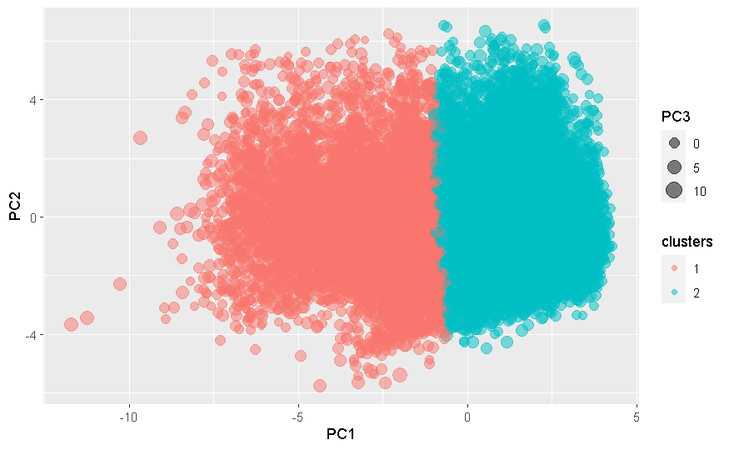
Unsupervised Learning – Clustering
Clustering was performed to group observations based on the 3 PC. That is, we find the observations which has most similar values in the principal components.
We ran the K-means with K = 2 using the projected observations onto the first 2 PCs from the previous part.
In the next step, we did the clustering for K=3,4,5,6 and selected the optimal cluster using the silhouette plots. From the silhouette scores is highest is 0.23 at k=2 so the two clusters are optimal.
Projected observation in two-dimension space and two different clusters are shown

Slide 11
Final Model Development
This is classification problem where we are trying to predict a binary outcome, which is the default, 1 or 0. The model output will be the probability of default. We build the logistic regression, Random Forest, Single classification tree and KNN and then compared the accuracy from all the models.
Training and Test Data:
Before the model development, we split the data into train and test set. We will be building the model on train data and making predictions on the test data to check how our model is performing. In order to do that we will be doing 10 folds Cross validation.

Slide 12

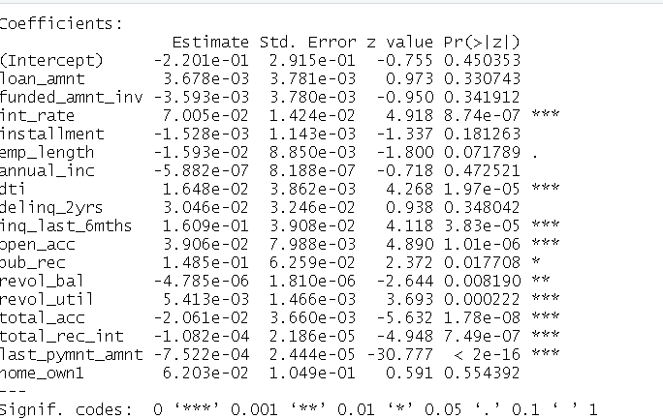
Logistic Regression
Logistic regression is a popular method to predict a categorical/binary response.
Logistic regression is useful for (discrete) qualitative responses referred to as categorical. It represents the probability that the response belongs to a category rather than telling about the outcome directly as default or not.
Below figure is the output from logistic regression model.
Looking at the output of the logistic regression we see that significant variables marked with asterisk. From the summary of our model, we can see that, judging by the significance parameter asterisk, there are some insignificant variables.

Slide 13
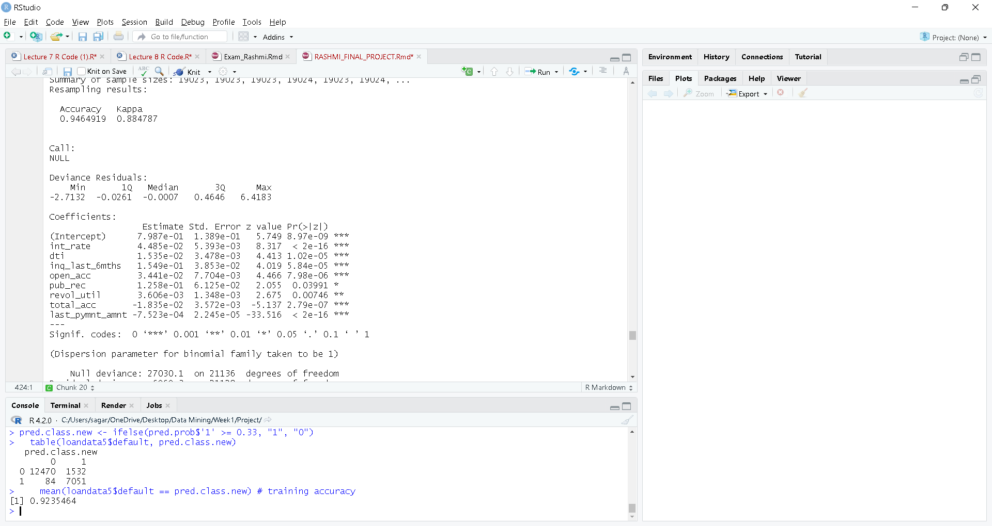
Logistic Regression Output Contd..
Looking at the output of the logistic regression we see that significant variables marked with asterisk. From the
summary of our model, we can see that, judging by the significance parameter asterisk, there are some
insignificant variables.
Variable relationships
From the variable co-efficients we can also understand the direction of relationship of independent variables with our target variable. For e.g. dti(debt-to-income has a +ve relationship with probability of bad and last payment amount has a –ve relationship with the probability of bad.
All significant variables

Slide 14
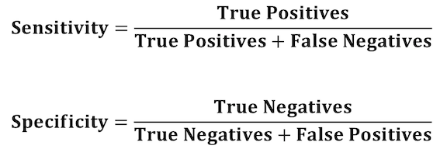
Model accuracy – Confusion matrix
To calculate the confusion matrix, we used the probability of 0.33 as our threshold, i.e., borrows with a probability greater than 0.33, are predicted to default, and borrowers with a probability below 0.33 are predicted not to default. Confusion matrix is given below:
Sensitivity and specificity is defined as below:
Thus, for out model we have:
Sensitivity = 7051/( 84 + 7051) = 0.988227
Specificity = 12470/(12470+1532)= 0. 8905871

Slide 15
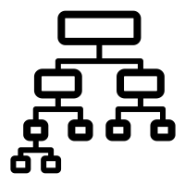
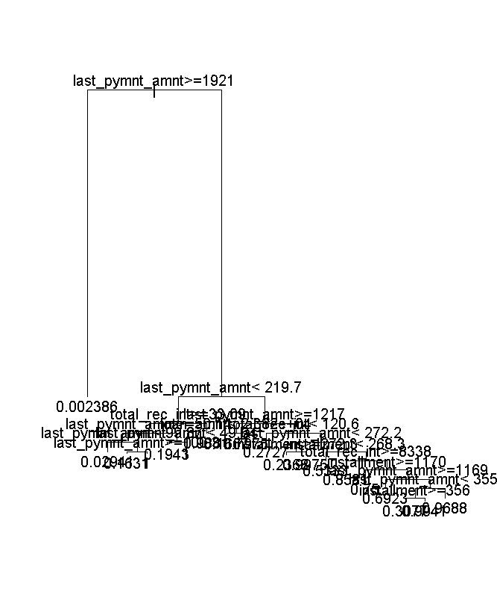
Single Classification Tree
Classification trees helps us understand the variables and their corresponding importance or relationship with target variable. The split determines the point at which the separation is made, and variable is able to segment the population in different groups which have similar variance in observations, or for e.g., in our case the split would separate low risk population with high-risk population between left nodes and right nodes
For our model:
The first cut is at the variable last_pymnt_amnt with a value 1921. The first split is here because of the low GINI Index for this variable and value.
If no split is made, then we got the value of GINI as 0.2235976.
If the split is made, then the value is 0.04452728 which has improved
Accuracy = 0.9751183.
In other words, we correctly predicted the response of our test values about 97.51% of the time.

Slide 16
Random Forest
Random forest, as the name suggests is a collection of large number of individual decision trees which predict the target and there is a majority voting that
happens between all trees and class with most votes becomes the model
prediction. Random forest is called random, because it picks the random observations and random variables to build each tree
Tree 1
Tree 2
Tree 5
Tree 4
Tree 6
Tree 3
For our model, the Accuracy was used to select the optimal model using the largest value of 97.45509. The final value used for the model was mtry = 5.
Tree 8
Tree 7

Slide 17
Summary
We see that the accuracy of classification trees and the random forest is highest as they are able to build the non linear relationships in the data whereas the Logistic tries to build more of linear relationships to predict the target
 | Accuracy (%)
Logistic Regression | 94.65
KNN | 91.37
Classification Trees | 97.51
Random Forest | 97.92
Notes:
Note: - As we notice from the results, this algorithm is not performing well as compared to others. We tried to drill down the root cause for the issue, but the spark provides very abstract level API for the algorithm implementation and doesn’t provide much control on its implementation. As a side work, we try implementing this same model in R and Python, where we first calculated the Maximum Likelihood Estimator based on the distribution of each feature and used combinations of Alpha & Beta values (For beta distribution) for prior. We then calculated the max posterior probability to each observations and achieved 92.6% precision.

Slide 18
Future Work
It would be great if lending club can provide the more recent samples to validate the model performance and stability. There have been a lot of macro-economic changes since 2018 like COVID and other changes like interest rates, new products, employment rate changes and inflation etc. that have led to significant changes in individual credit history. For example, payment plan/payment holidays, new products like buy now pay later have changed the behavior of how people shop for credit for their personal needs.
Notes:
SMOTE - Synthetic Minority Over-sampling Technique

